Slide 1

Python for Data Science
19CSE432: Lecture 23
B. Tech. 2021
Course Leader:
Dr. Yatish Bathla
yatishbathla.cs.et@msruas.ac.in
yatishbathla@outlook.com
Dr. Mohan Kumar
mohan.cs.et@msruas.ac.in

Slide 2
Lecture Objectives
At the end of this lecture, student will be able to understand
Utilizing Parallel Python
Distributing Tasks with Celery

Slide 3
Topics
Utilizing Parallel Python: Interprocess communication (IPC), Named pipes (Reading, Writing), Discovering PP, Using PP to calculate the Fibonacci series term and make a distributed Web crawler
Distributing Tasks with Celery: Understanding Celery, Understanding Celery's architecture, Setting up the environment, Dispatching a simple task, Using Celery to obtain a Fibonacci series term and make a distributed Web crawler

Slide 4
Utilizing Parallel Python
Use Parallel Python (PP) to perform parallel tasks with processes.
InterProcess Communication (IPC)
It consists of mechanisms that allow the exchange of information among processes.
There are several means to implement IPC, and in general, they depend on the
chosen architecture for the runtime environment.
In some cases, for example, where processes run on the same machine, we could use various types of communication, such as shared memory, message queues, and pipes.
When processes are physically distributed in clusters, for instance, we could use sockets and Remote Procedure Call (RPC).

Slide 5
Utilizing Parallel Python
Named pipes
For each task we perform, there is a file somewhere, and we can also find a file descriptor attached to it, which allows us to manipulate these files.
Named pipes are nothing but mechanisms that allow IPC communication through the use of file descriptors associated with special files that implement, for instance, a First-In, First-Out (FIFO) scheme for writing and reading the data.
In Python, named pipes are implemented through the system calls. To write a Named Pipe, We start with the input of the os module, which will provide access to the system calls
To read Named pipe, It uses the os module to manipulate the named pipes. The main chunk, which triggers the process, is simple. We define a label to the named pipe we will use.

Slide 6
Utilizing Parallel Python
Discovering PP
we will use a Python module, PP, to establish IPC communication not only among local processes, but also physically distributed throughout a computer network.
The PP module implements the execution of parallel code in two ways.
The first way considers the SMP architecture, where there are multiple processors/cores in the same machine.
The second alternative would be distributing the tasks through machines in a network, configuring, and thus forming a cluster.
There is a class, called Server, present in the API of PP, which we can use to encapsulate and dispatch tasks among local and remote processes.
An instance of the Server class has, among several methods, the submit method that allows us to dispatch tasks to their destinations.

Slide 7
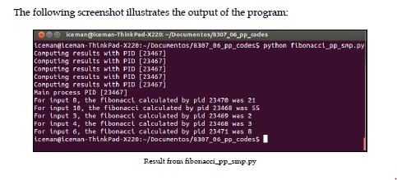
Utilizing Parallel Python
calculate the Fibonacci series term on SMP architecture
We will import only two modules for this implementation, os and pp. The os module will be used only to obtain a PID of the processes in execution. We will have a list called input_list with the values to be calculated and a dictionary to group the results, which we will call result_dict.

Slide 8
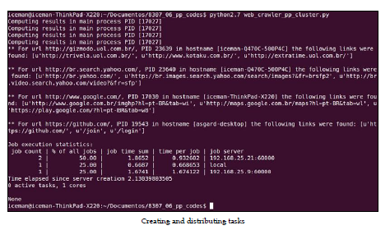
Utilizing Parallel Python
Make a distributed Web crawler
The idea is to dispatch the executions to the three machines listed using PP. For this,
we will make use of a case study of the Web crawler. For each URL informed in the input_list, we will dispatch a local or remote process for execution, and at the end of each execution, a callback function will group the URLs and their first three links found.

Slide 9
Distributing Tasks with Celery
We will study how to distribute tasks among different machines in a network by using the Celery framework.
Understanding Celery
Celery is a framework that offers mechanisms to lessen difficulties while creating distributed systems. The Celery framework works with the concept of distribution of work units (tasks) by exchanging messages among the machines that are interconnected as a network, or local workers.
A task is the key concept in Celery; any sort of job we must distribute has to be encapsulated in a task beforehand.
It distributes tasks in a transparent way among workers that are spread over the Internet, or local workers
It supports synchronous, asynchronous, periodic, and scheduled tasks

Slide 10
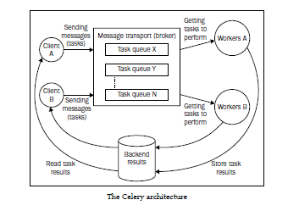
Distributing Tasks with Celery
Understanding Celery's architecture
Celery has an architecture based on pluggable components and a mechanism of message exchange that uses a protocol according to a selected message transport (broker).

Slide 11
Distributing Tasks with Celery
Understanding Celery's architecture
The client components, as presented in the previous diagram, have the function of creating and dispatching tasks to the brokers.
Demonstrates the definition of a task by using the @app.task decorator, which is accessible through an instance of Celery application that, for now, will be called app.
There are several types of tasks: synchronous, asynchronous, periodic, and scheduled. When we perform a task call, it returns an instance of type AsyncResult.
The AsyncResult object is an object that allows the task status to be checked, its ending, and obviously, its return when it exists. However, to make use of this mechanism, another component, the result backend, has to be active.
The Message transport (broker) is definitely a key component in Celery. Through it, we get to send and receive messages and communicate with workers
The most complete in terms of functionality are RabbitMQ and Redis. We will use Redis as a broker as well as result backend.

Slide 12
Distributing Tasks with Celery
Understanding Celery's architecture
A broker has the function of providing a means of communication between client applications that send tasks and workers that will execute them. This is done by using task queues. We can have several network machines with brokers waiting to receive messages to be consumed by workers.
Workers are responsible for executing the tasks they have received. Celery displays a series of mechanisms so that we can find the best way to control how workers will behave. We can define the mechanisms as follows: Concurrency mode, Remote control, Revoking tasks
The result backend component has the role of storing the status and result of the task to return to the client application. From the result backend supported by Celery, we can highlight RabbitMQ, Redis, MongoDB, Memcached, among others.

Slide 13
Distributing Tasks with Celery
Setting up the environment
we will set up two machines in Linux. The first one, hostname foshan, will perform the client role, where app Celery will dispatch the tasks to be executed. The other machine, hostname Phoenix, will perform the role of a broker, result backend, and the queues consumed by workers.
Setting up the Client Machine
We will set up a virtual environment with Python 3.3, using the tool pyvenv. The goal of pyvenv is to not pollute Python present in the operating system with additional modules, but to separate the developing environments necessary for each project.
Now, we have a virtual environment and starting off from the point from where you already installed setuptools or pip, we will install the necessary packages for our client. Let's install the Celery framework with the following command:
$pip install celery

Slide 14

Distributing Tasks with Celery
Setting up the environment
we will set up two machines in Linux. The first one, hostname foshan, will perform the client role, where app Celery will dispatch the tasks to be executed. The other machine, hostname Phoenix, will perform the role of a broker, result backend, and the queues consumed by workers.

Slide 15
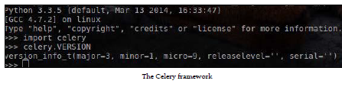
Distributing Tasks with Celery
Setting up the Client Machine
We will set up a virtual environment with Python 3.3, using the tool pyvenv. The goal of pyvenv is to not pollute Python present in the operating system with additional modules, but to separate the developing environments necessary for each project.
Now, we have a virtual environment and starting off from the point from where you already installed setuptools or pip, we will install the necessary packages for our client. Let's install the Celery framework and support to Redis with the following command:
$pip install celery[redis]

Slide 16
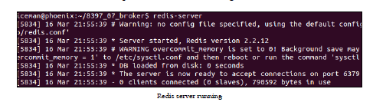
Distributing Tasks with Celery
Setting up the Server Machine
To set up the server machine, we will start by installing Redis, which will be our broker and result backend. We will do this using the following command:
$sudo apt-get install redis-server
To start Redis, just execute the following command:
$redis-server
If it was successful, an output similar to the following screenshot will be exhibited:

Slide 17
Distributing Tasks with Celery
Dispatching a simple task
At this point, we have a ready environment. Let's test it by sending a task that will calculate the square root of a value and return a result. First, we must define our task module tasks.py inside the server. Let's check the description of the tasks.py module. the following chunk of code, we have imports necessary for our function that will calculate the square root:
from math import sqrt
from celery import Celery
Now, let's create the following instance of Celery, which will represent our client application:
app = Celery('tasks', broker='redis://192.168.25.21:6379/0')

Slide 18
Distributing Tasks with Celery
Dispatching a simple task
Then, we have to set up our result backend, which will also be in Redis, as follows:
app.config.CELERY_RESULT_BACKEND = 'redis://192.168.25.21:6379/0’
With the basics ready, let's define our task with the @app.task decorator:
@app.task
def square_root(value):
return sqrt(value)
At this point, since we have our tasks.py module defined, we need to initiate our workers inside the server, where Redis and Celery (with support to Redis) are installed.
$celery –A tasks worker –-loglevel=INFO

Slide 19
Distributing Tasks with Celery
Dispatching a simple task
Now, we have a Celery server waiting to receive tasks and send them to workers. The next step is to create an application on the client side to call tasks.
In the machine that represents the client, we have our virtual environment celery_env already set up as we did in the last slides. So, now it is simpler to create a step-by-step module task_dispatcher.py, as follows:
We import the logging module to exhibit information referring to the execution of the program and the Celery class inside the celery module, as follows:
import logging
from celery import Celery
2. The next step is to create an instance of the Celery class informing the module containing the tasks and then the broker, as done in the server side. This is done with the following code:
app = Celery('tasks’, broker='redis://192.168.25.21:6379/0')
app.conf.CELERY_RESULT_BACKEND = 'redis://192.168.25.21:6397/0'

Slide 20
Distributing Tasks with Celery
Dispatching a simple task
3. let us create a function to encapsulate the sending of the sqrt_task(value) task. We will create the manage_sqrt_task(value) function as follows:
def manage_sqrt_task(value):
result = app.send_task('tasks.sqrt_task', args=(value,))
logging.info(result.get())
4. In the __main__ block, we executed the call to the manage_sqrt_task(value) function by passing the input value as 4:
if __name__ == '__main__’:
manage_sqrt_task(4)

Slide 21
Distributing Tasks with Celery
Compute Fibonacci series terms with multiple inputs
Let us again go and distribute our multiple inputs in order to calculate the nth Fibonacci term, each of them in a distributed way. The function that calculates Fibonacci will change a little in relation to the previous chapters. The changes are small; now we have the @app.task decorator and a small change in the return message.
Distributed Web Crawler
We will now move on to adapting our Web crawler to Celery. We already have webcrawler_queue, which is responsible for encapsulating web-type hcrawler tasks. However, in the server side, we will create our crawl_task task inside the tasks.py module.

Slide 22
Summary
Utilizing Parallel Python: We studied the use of a low-level resource to establish communication among processes with no relation between them. Further, we have taken a look at using the PP module, which helps us abstract the communication among the local processes, including distributed processes. PP is a convenient tool for building simple, small, parallel, and distributed Python applications.
Distributing Tasks with Celery: We discussed the Celery distributed task queue. We also visualized its architecture, analyzed its key components, and saw how to set up an environment to build basic applications with Celery.

